Slide 1
Unit 2
Exception handling

Slide 2
Java - Exceptions
An exception is an unwanted or unexpected event, which occurs during the execution of a program.
When an Exception occurs the normal flow of the program is disrupted and the program/Application terminates abnormally, which is not recommended, therefore, these exceptions are to be handled.

Slide 3
Error vs Exception
Error: An Error indicates serious problem that a reasonable application should not try to catch.
Three categories of errors are:
Syntax errors arise because the rules of the language have not been followed. They are detected by the compiler.
Runtime errors occur while the program is running if the environment detects an operation that is impossible to carry out.
Logic errors occur when a program doesn't perform the way it was intended
Exception: Exception indicates conditions that a reasonable application might try to catch.

Slide 4
Exception handler
In Java, an exception is an object of a relevant exception class.
When an error occurs in a method, it throws out an exception object that contains the information about where the error occurred and the type of error.
The event handling code is called exception handler.
Exception handling is a mechanism that is used to handle runtime errors such as classNotFound and IO.

Slide 5
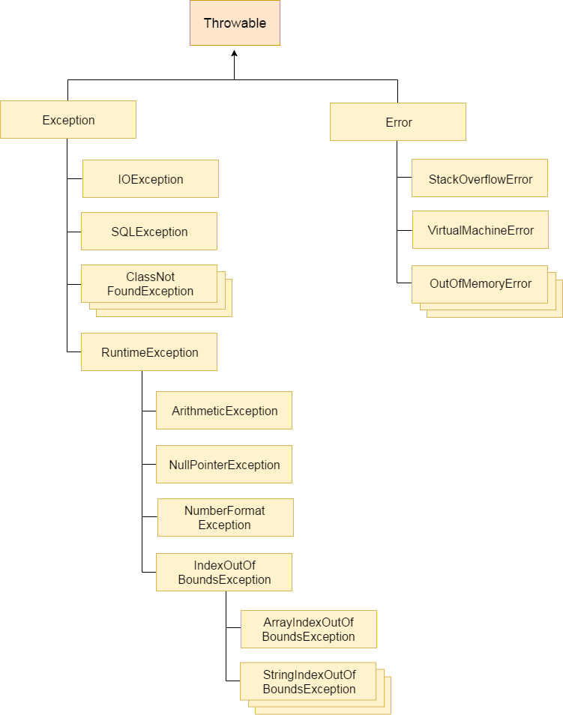
Hierarchy of Java Exception classes

Slide 6
System Errors
System errors are thrown by JVM and represented in the Error class. The Error class describes internal system errors. Such errors rarely occur. If one does, there is little you can do beyond notifying the user and trying to terminate the program gracefully.

Slide 7
Exceptions
Exception describes errors caused by your program and external circumstances. These errors can be caught and handled by your program.

Slide 8
Runtime Exceptions
RuntimeException is caused by programming errors, such as bad casting, accessing an out-of-bounds array, and numeric errors.

Slide 9
Hierarchy of Standard Exception Classes
The subclasses of Exception class are broadly subdivided into two
categories.
Unchecked exceptions - an exception that occurs at the time of execution. These are also called as Runtime Exceptions. These include programming bugs, such as logic errors or improper use of an API. Runtime exceptions are ignored at the time of compilation.
Checked exceptions - an exception that is checked (notified) by the compiler at compilation-time, these are also called as compile time exceptions. These exceptions cannot simply be ignored, the programmer should take care of (handle) these exceptions.

Slide 10
Checked Exceptions vs. Unchecked Exceptions
RuntimeException, Error and their subclasses are known as unchecked exceptions. All other exceptions are known as checked exceptions, meaning that the compiler forces the programmer to check and deal with the exceptions.

Slide 11
Unchecked Exceptions
In most cases, unchecked exceptions reflect programming logic errors that are not recoverable.
For example, a NullPointerException is thrown if you access an object through a reference variable before an object is assigned to it;
An IndexOutOfBoundsException is thrown if you access an element in an array outside the bounds of the array.
These are the logic errors that should be corrected in the program. Unchecked exceptions can occur anywhere in the program.
To avoid cumbersome overuse of try-catch blocks, Java does not mandate you to write code to catch unchecked exceptions.

Slide 12
Checked or Unchecked Exceptions
Unchecked exception.

Slide 13
Java Exception Keywords
Keyword | Description
try | The "try" keyword is used to specify a block where we should place exception code. The try block must be followed by either catch or finally. It means, we can't use try block alone.
catch | The "catch" block is used to handle the exception. It must be preceded by try block which means we can't use catch block alone. It can be followed by finally block later.
finally | The "finally" block is used to execute the important code of the program. It is executed whether an exception is handled or not.
throw | The "throw" keyword is used to throw an exception.
throws | The "throws" keyword is used to declare exceptions. It doesn't throw an exception. It specifies that there may occur an exception in the method. It is always used with method signature.

Slide 14
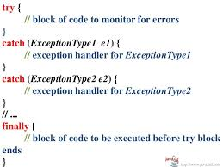
Declaring and Catching Exceptions

Slide 15
try, catch and finally Block

Slide 16
try {} Block
The program code that is most likely to create exceptions is kept in the try block, which is followed by the catch block to handle the exception.
In normal execution, the statements are executed and if there are no exceptions, the program flow goes to the code line after the catch blocks.
However, if there is an exception, an exception object is thrown from the try block.
Its data members keep the information about the type of
exception thrown.
The program flow comes out of the try block and searches for an appropriate catch block with the same type as its argument.

Slide 17
catch {} Block
A catch block is meant to catch the exception if the type of its argument matches with the type of exception thrown.
If the type of exception does not match the type of the first catch block, the program flow checks the other catch blocks one by one.
If the type of a catch block matches, its statements are executed.
If none matches, the program flow records the type of exception, executes the finally block, and terminates the program.

Slide 18
finally {} Block
This is the block of statements that is always executed even when there is an exceptional condition, which may or may not have been caught or dealt with.
Thus, finally block can be used as a tool for the clean up operations and for recovering the memory resources.
For this, the resources should be closed in the finally block.
This will also guard against situations when the closing operations are bypassed by statements such as continue, break, or return.

Slide 19
Trace a Program Execution
animation
Suppose no exceptions in the statements
try {
statements;
}
catch(TheException ex) {
handling ex;
}
finally {
finalStatements;
}
Next statement;

Slide 20
Trace a Program Execution
animation
The final block is always executed
try {
statements;
}
catch(TheException ex) {
handling ex;
}
finally {
finalStatements;
}
Next statement;

Slide 21
Trace a Program Execution
animation
Next statement in the method is executed
try {
statements;
}
catch(TheException ex) {
handling ex;
}
finally {
finalStatements;
}
Next statement;

Slide 22
Trace a Program Execution
animation
try {
statement1;
statement2;
statement3;
}
catch(Exception1 ex) {
handling ex;
}
finally {
finalStatements;
}
Next statement;
Suppose an exception of type Exception1 is thrown in statement2

Slide 23
Trace a Program Execution
animation
try {
statement1;
statement2;
statement3;
}
catch(Exception1 ex) {
handling ex;
}
finally {
finalStatements;
}
Next statement;
The exception is handled.

Slide 24
Trace a Program Execution
animation
try {
statement1;
statement2;
statement3;
}
catch(Exception1 ex) {
handling ex;
}
finally {
finalStatements;
}
Next statement;
The final block is always executed.

Slide 25
Trace a Program Execution
animation
try {
statement1;
statement2;
statement3;
}
catch(Exception1 ex) {
handling ex;
}
finally {
finalStatements;
}
Next statement;
The next statement in the method is now executed.

Slide 26
Program Example -1
import java.io.*;
public class Unchecked_Demo {
public static void main(String args[]) {
int num[] = {1, 2, 3, 4};
System.out.println(num[5]);
System.out.println("Progfor Unchecked Exception");
}
}

Slide 27
Program Example- 2
import java.io.*;
public class Exception_Demo {
public static void main(String args[]) {
System.out.println("Program for Exception handling");
try {
int num[] = {1, 2, 3, 4};
System.out.println("Accessing 5th element: "+num[5]);
}
catch(ArrayIndexOutOfBoundsException e)
{
System.out.println("Exception thrown :" + e);
}
System.out.println("Out of the try catch block");
}
}

Slide 28
Program Example- 3
import java.io.*;
public class Exception_Demo {
public static void main(String args[]) {
System.out.println("Program for Exception handling");
try {
int num[] = {1, 2, 3, 4};
System.out.println("Accessing 5th element: "+num[5]);
}
catch(ArrayIndexOutOfBoundsException e)
{
System.out.println("Exception thrown :" + e);
}
finally {
System.out.println("The finally statement is executed");
}
System.out.println("Out of the try catch block");
}
}

Slide 29
Program Example 4 – Multiple catch

Slide 30
Java Exception Handling Example 5
public class JavaExceptionExample{
public static void main(String args[]){
try{
//code that may raise exception
int data=100/0;
}catch(ArithmeticException e){System.out.println(e);}
//rest code of the program
System.out.println("rest of the code...");
}
}

Slide 31
Output:
Exception in thread main java.lang.ArithmeticException:/ by zero
rest of the code...

Slide 32
Common Scenarios of Java Exceptions
1) A scenario where ArithmeticException occurs
int a=50/0;//ArithmeticException
2)A scenario where NullPointerException occurs
String s=null;
System.out.println(s.length());
//NullPointerException

Slide 33
3) A scenario where NumberFormatException occurs
String s="abc";
int i=Integer.parseInt(s);//NumberFormatException
4) A scenario where ArrayIndexOutOfBoundsException occurs
int a[]=new int[5];
a[10]=50; //ArrayIndexOutOfBoundsException

Slide 34
throw and throws in Java
The throw keyword in Java is used to explicitly throw an exception from a method or any block of code.
We can throw either checked or unchecked exception.
The throw keyword is mainly used to throw custom exceptions.

Slide 35
public class TestThrow1{
static void validate(int age){
if(age<18)
throw new ArithmeticException("not valid");
else
System.out.println("welcome to vote");
}
public static void main(String args[]){
validate(13);
System.out.println("rest of the code...");
}
}

Slide 36
throw and throws in Java
throws is a keyword in Java which is used in the signature of method to indicate that this method might throw one of the listed type exceptions.
The caller to these methods has to handle the exception using a try-catch block.

Slide 37
To prevent this compile time error we can handle the exception in two ways:
By using try catch
By using throws keyword
Prg - ThrowsExceptionDemo

Slide 38
Important points to remember about throws keyword:
throws keyword is required only for checked exception and usage of throws keyword for unchecked exception is meaningless.
throws keyword is required only to convince compiler and usage of throws keyword does not prevent abnormal termination of program.
By the help of throws keyword we can provide information to the caller of the method about the exception.

Slide 39
User Defined Exception
User-defined exception that extends the Exception class, making it a checked exception.
An exception class is like any other class, containing useful fields and methods.
Rules:
All exceptions must be a child of Throwable.
If you want to write a checked exception that is automatically enforced by the Handle or Declare Rule, you need to extend the Exception class.
If you want to write a runtime exception, you need to extend the RuntimeException class.
Eg Prg - BankDemo

